Slide 1
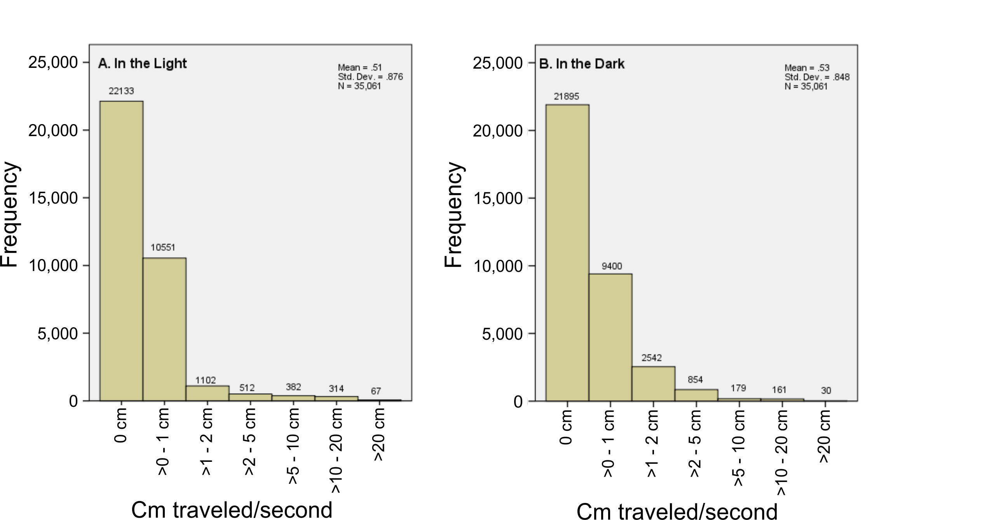
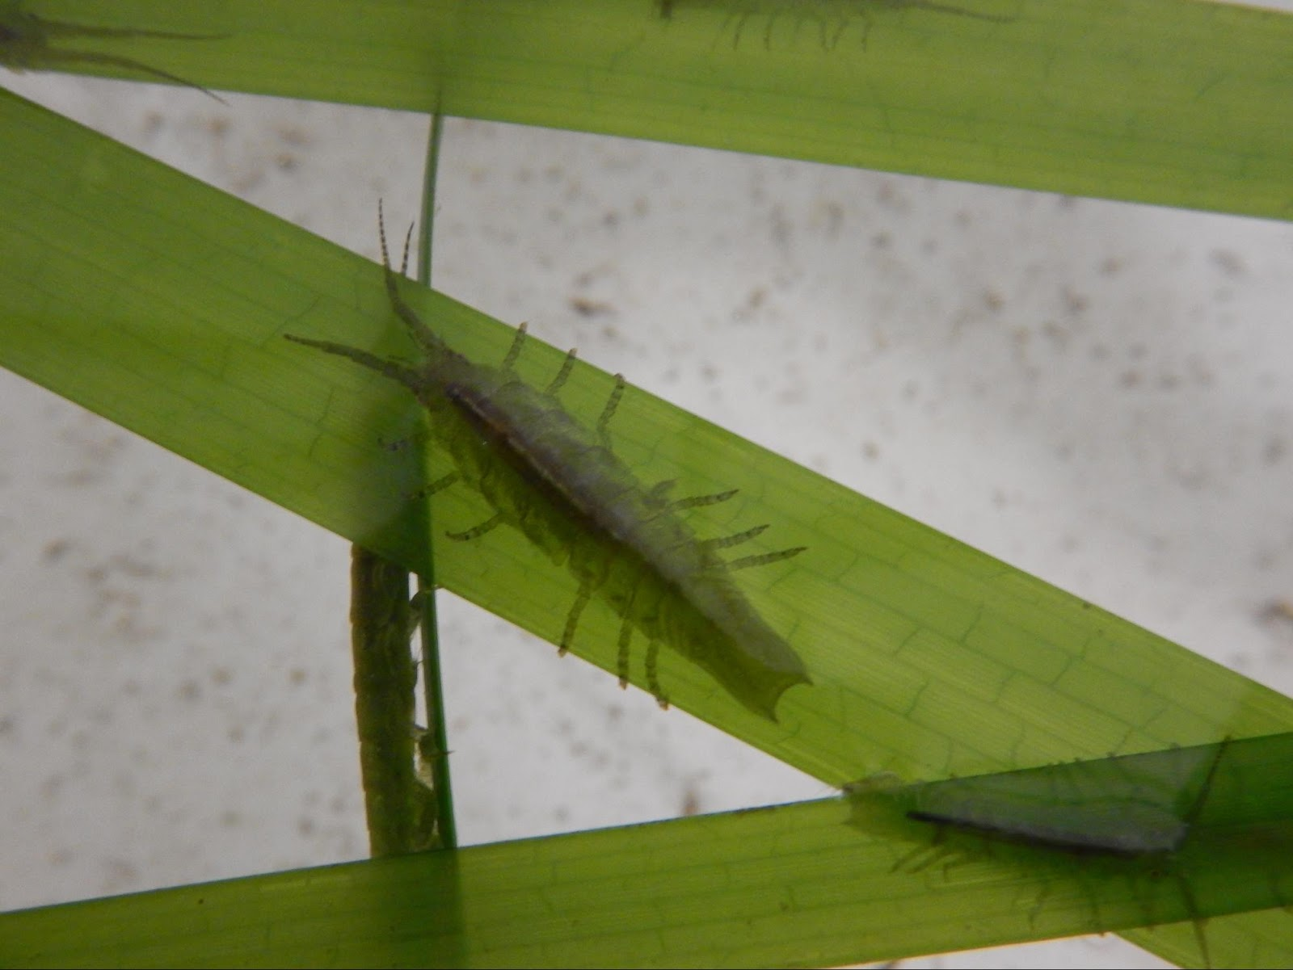
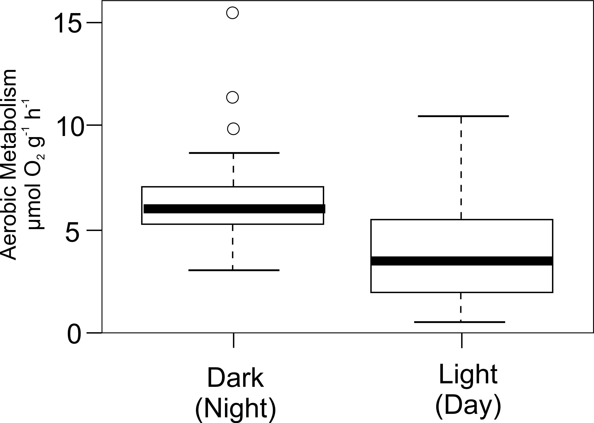
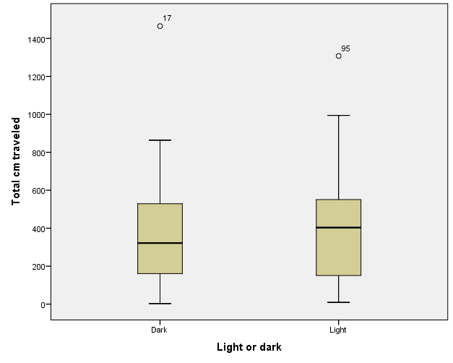
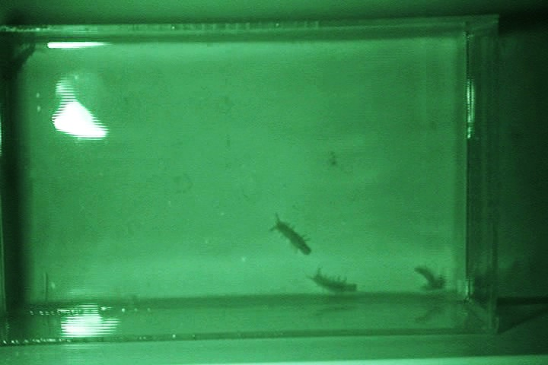
Activity Levels of Pentidotea resecata Support Conclusion That the Animal is Photosynthetic
Sarah J. Anderson, Faith E. Hunnicutt, and David L. Cowles; Walla Walla University, College Place, WA
Abstract
Methods
The green marine isopod Pentidotea resecata lives on eelgrass in shallow beds, exposed to bright sunlight (1). Previous dissection work revealed that the animals typically have abundant viable-appearing plant and algal cells in their gut (5). Analysis of aerobic respiration showed sharply lower respiration rates in the light. This result suggested that the animals may actually be carrying out photosynthesis along with respiration during the daytime light trials (2). However, activity level was not formally quantified in these studies and a pattern of consistently higher activity during night-time darkness could produce a similar result. In this experiment we tracked activity levels of the animals during daytime light periods and nighttime dark periods. There was no significant difference between the activity levels in the light and in the dark, further supporting the conclusion that photosynthesis does indeed take place inside these animals while in the light.
In the summer of 2016, P. resecata were collected by hand net or plankton net in the shallow Zostera marina eelgrass beds of Padilla Bay in Anacortes, Washington. Only individuals over 4 cm in length were used for this experiment. Shortly after collection, the isopods were transferred to circulating sea water tanks filled with Z. marina, located at the Rosario Beach Marine Laboratory (RBML). For the experiment, 39 animals were transferred in groups of 4 or 5 to a 60 x 36 cm arena filled 5 cm deep with seawater. After a 10-minute acclimation period to the arena, their activity was filmed from directly overhead for 15 minutes both during the daytime and during night-time darkness (Figure 3). An infrared light was used to allow filming in the dark. One frame per second from the resulting video was imported into ImageJ (900 frames per 15-minute period), and the manual tracking feature was used to track the movement per second and total movement of each isopod during the period (Figure 4). All animals were tested during both day and night. Some groups were tested in the light first, while others were tested first in the dark. After a square-root transformation to normalize the data, total movement and movement per second of the isopods were compared between the day (light) and night (dark) using ANOVA in SPSS® version 24. After use, the isopods were released to the eelgrass in Padilla Bay.
Figure 6. The second-by-second pattern of movement of P. resecata in the light (A) and in the dark (B). The patterns are nearly indistinguishable and few moves of were > 2 cm/second, which would correspond to about ½ body length per second.
Discussion
These results clearly show that a higher level of activity during the night is not the reason that these animals use oxygen significantly more rapidly during the night than during the day (2). Although activity level can have a strong effect on the rate of aerobic metabolism, there was no significant difference between the animals’ activity levels during night and day. Furthermore, the large majority of time the animals were not moving at all or moving very slowly. Under these conditions activity level is likely to have little effect on rate of aerobic metabolism. These results eliminate differences in activity as the source of the differences in rate of oxygen usage, and support the conclusion that photosynthesis within the animal’s gut is indeed the source of this difference.
Figure 1. Pentidotea resecata on Zostera marina eelgrass at RBML.
Figure 2. Rates of aerobic metabolism of P. resecata during the night are significantly higher than during the day (P = 0.0001). From (2).
Introduction
Figure 4. The tracks of 5 individuals over 15 minutes in the arena, as recorded by ImageJ.
Although internal symbiosis with photosynthetic algae is common among diploblastic animals such as corals, very few species from more complex groups have such a relationship with algae or plant cells (1). The large isopod Pentidotea resecata (Figure 1) lives and feeds in shallow, sunlit marine eelgrass beds. Its strong green color led to the question of whether it could be one of those unusual higher animal species which contains internal photosynthetic symbionts. Earlier dissection work has revealed viable-appearing plant cells in its gut and a chlorophyll-like fluorescence (5). Furthermore, the animal’s metabolic use of oxygen is sharply higher in the dark than during the daylight (Figure 2), which is consistent with photosynthesis taking place inside its tissues and counteracting some of the oxygen usage due to respiration (2). However, this same result could be due to sharply higher activity levels during the dark hours. In this experiment we carefully quantified the activity levels of P. resecata during the light and dark hours of the day to determine whether high night-time activity may serve as an alternative explanation for their day-night differences in measured rate of aerobic metabolism.
Results
Conclusions
There was no significant difference between the total distances moved by the animals in the light and in the dark (Figure 5, F = 0.270, P = 0.605). The patterns of second-by-second movement in the day and night were virtually indistinguishable (Figure 6). Animals spent most of their time standing still or with only small movements. Only occasionally did animals move at more than 2 cm/second.
Since there is no significant difference between the activity levels of P. resecata in the day versus the night, it is evident this isopod uses photosynthesis within its gut, which is the causation of lower aerobic metabolic rates during the day versus the night.
Photosynthesis is the cause for lower aerobic metabolic rates during the day.
P. resecata does utilize photosynthesis within its gut.
Acknowledgements
Our sincere thanks to Leah Dann and Judelle Johnson for help collecting isopods and access to their data, to Brandon Pierce for more help collecting isopods, to the Walla Walla University Biology Department for supporting this research, and to the Rosario Beach Marine Laboratory for providing the facilities.
Figure 3. 5 individuals in the arena for recording activity. In this view from the video camera the arena is in darkness, illuminated by an infrared light.
Literature Cited
(1) Cowles, D. (2012). Pentidotea resecata. Retrieved August 1, 2016, from
https://inverts.wallawalla.edu/Arthropoda/Crustacea/Malacostraca/Eumalacostraca/Peracarida/Isopoda/Valvifera/Family-
Idoteidae/Idotea_resecata.html
(2) Cowles, J. (2015). Does Photosynthesis Take Place in the Gut of Pentidotea resecata? M.S. thesis, Walla Walla University.
(3) Kozloff, E., & Price, L. (1996). Marine invertebrates of the Pacific Northwest. Seattle: University of Washington Press.
(4) Lee, W., & Gilchrist, B. (1972). Pigmentation, color change and the ecology of the marine isopod Idotea resecata. Journal of
Experimental Marine Biology and Ecology, 10(1), 1–27.
(5) McLarty, S. (2015). Gut Content and Pigment Analysis in the Marine Isopod Pentidotea Resecata.
M.S. thesis, Walla Walla University.
Figure 5. Boxplot of the total cm traveled by all P. resecata tested in the dark versus the light.

